Slide 1
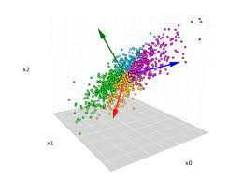
Principal component analysis (pca)
NAME – ADITYA KUMAR
UNIVERSITY ROLL NO : 34230821034
PAPER NAME : MACHINE LEARNING APPLICATIONS
PAPER CODE : PCC-AIML601
SEMESTER/YEAR : 6TH SEM/ 3RD YEAR
DEPARTMENT :CSE(AI&ML)

Slide 2
What is pca? & why pca?
What is PCA? Principal Component Analysis(PCA) was introduced by Karl Pearson in 1901. PCA is a statistical, dimensionality reduction method/algorithm which basically derives new features from the existing ones keeping as much information as possible. PCA is an unsupervised learning algorithm. It is also widely used as a preprocessing step for supervised learning algorithm. For example- reduce the number of dimensions in the training dataset and De-noise the data. PCA is a linear dimensionality reduction algorithm. | Why PCA? PCA serves several important needs in machine learning: Dimensionality Reduction Problem: In many real-world datasets, there are often a large number of features, which can lead to the curse of dimensionality. Need: PCA reduces the dimensions of the data, helping to focus on the most significant features and relationships. Reducing the number of variables while retaining essential information. 2. Interpretability and Visualization Problem: High-dimensional data can be challenging to visualize and interpret. Need: PCA provides a lower-dimensional representation of the data, making it easier to visualize in two or three dimensions. 3. It is also commonly used for noise filtering, feature extraction, improved model performance, and more.

Slide 3
PCA GOAL & ITS WORKING
If you have a dataset with n features X_1, X_2…….X_n. Initially your data is plotted or represented using n- axes. But you want to replace these n-features with just one, two or three features.
How can you choose a new axis, let’s call it the z-axis, that is somehow a good feature for capturing of representing the data?
Let’s take a look how PCA does this.
4. How we can find the axis (axes) so that the variance of the projected data will be maximum.
GOAL OF PCA/PHILOSOHY OF PCA
PCA seeks the direction for which the spread (variance) of the projected data is maximum.
Maximize the spread (variance) of projected data and simultaneously minimizing reconstruction error.

Slide 4



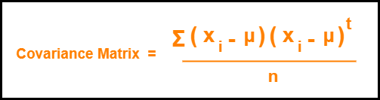
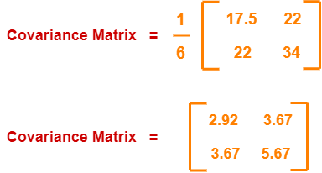
Pca steps:-
1. Get Data X_1, X_2…….X_n R^nx1.
Consider the two dimensional patterns (2, 1), (3, 5), (4, 3), (5, 6), (6, 7), (7, 8).
Construct a design matrix X of order m x n.
Calculate the Mean Vector (μ) . Then calculate the (MSD) Mean Subtracted Data (X ¯= X-μ).
Find the Covariance Matrix(Σ) = 1/m*(X^T*X). Covariance matrix is real symmetric matrix of order n x n.

Slide 5
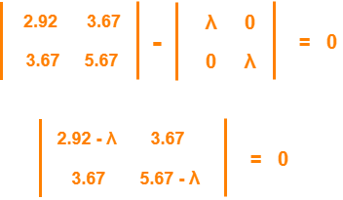
5. Calculate the Eigen values and Eigen vectors of the covariance matrix. λ is an eigen value for a matrix M if it is a solution of the characteristic equation |M – λI| = 0.
So, we have-
Solving the determinant, we get λ = 8.22, 0.38. Thus, two Eigen values are λ₁ = 8.22 and λ₂ = 0.38.
Clearly, the second eigen value is very small compared to the first eigen value.
So, the second eigen vector can be left out.
Eigen vector corresponding to the greatest eigen value is the principal component for the given data set.
So. we find the eigen vector corresponding to eigen value λ₁.
We use the following equation to find the eigen vector- Σμ = λμ

Slide 6


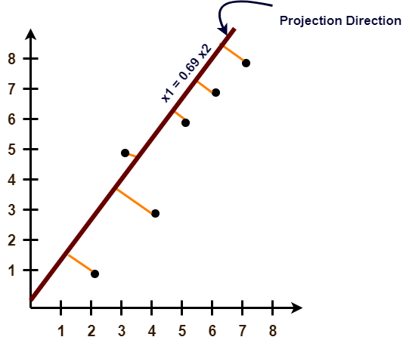

Substituting the values in the above equation, we get-
On simplification, we get-
5.3X₁ = 3.67X₂ ………(1)
3.67X₁ = 2.55X₂ ………(2)
From (1) and (2), X₁ = 0.69X₂
From (2), the eigen vector is-
Thus, principal component for the given data set is-
Lastly, we project the data points onto the new subspace as-

Slide 7
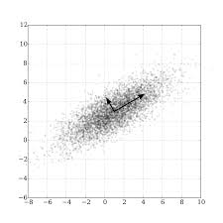
Take axis μ of order n x 1.
Then we calculate the weight vector W=X¯μ (projection). Here W = projected data.
Then calculate Variance of projected data i.e., Variance (W) = 1/m Σi=1 to m (w^(i) – Mw)^2.
The above equation simplifies to Variance (W) = 1/m Σi=1 to m (W^(i))^2. as the mean centered data is
zero., so we can eliminate the mean term.
We can now simplify It more and get the equation –
Variance (W) = 1/m*(W^T * w).
Now we have to maximize this equation Variance (W) = 1/m*(W^t * w). Subject to constraint μ^T μ=1
As X&Y are orthogonal and orthonormal. Then calculate this by using constant optimization problem.
On doing some math works we get :-
Σμ = λμ which is Eigen value - Eigen vector equation.
where, μ= Eigen Vector of Covariance Matrix Σ
λ= Eigen value of Covariance Matrix Σ
Hence basis vector PCA are the Eigen vectors of covariance matrix.
Then select the Eigen Value corresponding to the highest Eigen Vector and write it in the form of Orthonormal Eigen Vector ( so this is our PRINCIPAL COMPONENT) which has more information means more spread.

Slide 8
RECONSTRUCTION OF DATA
In (PCA), the main objective is to transform the original data into a new set of variables called principal components, which are linear combinations of the original variables. The primary reason for reconstructing the data is to reduce its dimensionality while retaining as much of the original information as possible.
We project the data into low dimensional subspace of dimension k, i.e. we are choosing k numbers of Eigen vectors , each Eigen Vector of dimension. Take, X=[x1 x2 x3] U = [u1 u2 ……u_k]
Project X on U means X is projected on each Eigen Vector and k nos. of Weights are generated. W=U^T*X
Therefore, reconstruction(r)=W^T*U^T OR r^t=W*U of dimension nx1.
Reconstruction Error = 1/m (X-r^t)^T* (X-r^t)
On solving this we get - ERROR = ΣX-ΣW
Where, ΣW = variance of W Variance + Reconstruction Error = Construction
Hence to minimize reconstruction error we need to maximize the variance of projected data Maximizing the variance of projected data W gives the eigenvector of the covariance matrix of data X which is the basis of PC.

Slide 9
Applications & limitations of pca
Applications
Limitations
Used to reduce Over fitting visualize multidimensional data.
It is used to reduce the number of dimensions in healthcare data.
PCA can help resize an image.
It helps in data compression and hence reduce storage space.
Speeding of training of a supervised learning model.
It may lead to some amount of data loss.
We may not know how many principal components to keep.
PCA is sensitive to outliers.
PCA tends to find linear correlations between variables, which is sometimes undesirable.
PCA is not robust to missing values.

Slide 10
Thank you

